Slide 1
Sales Volume Analysis using different Graphs
File created on: 2/23/2024 4:06:02 PM

Slide 2
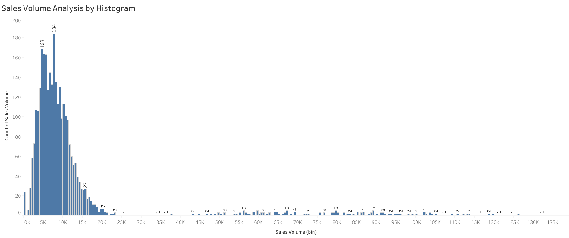

Slide 3
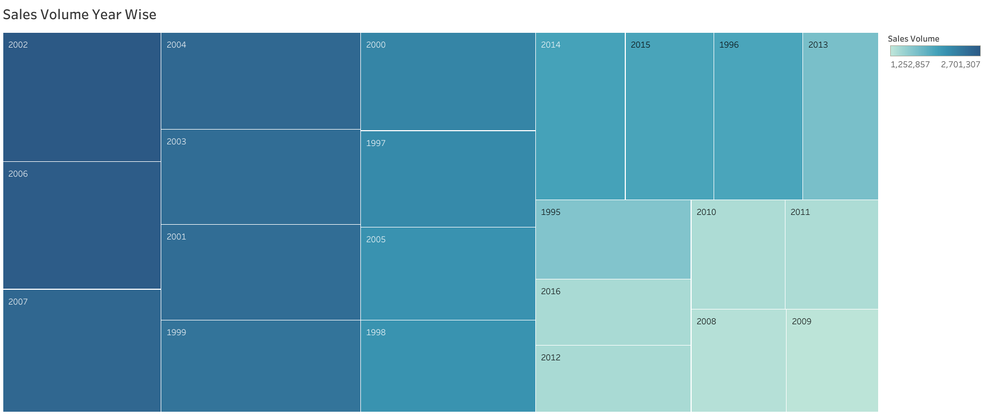

Slide 4
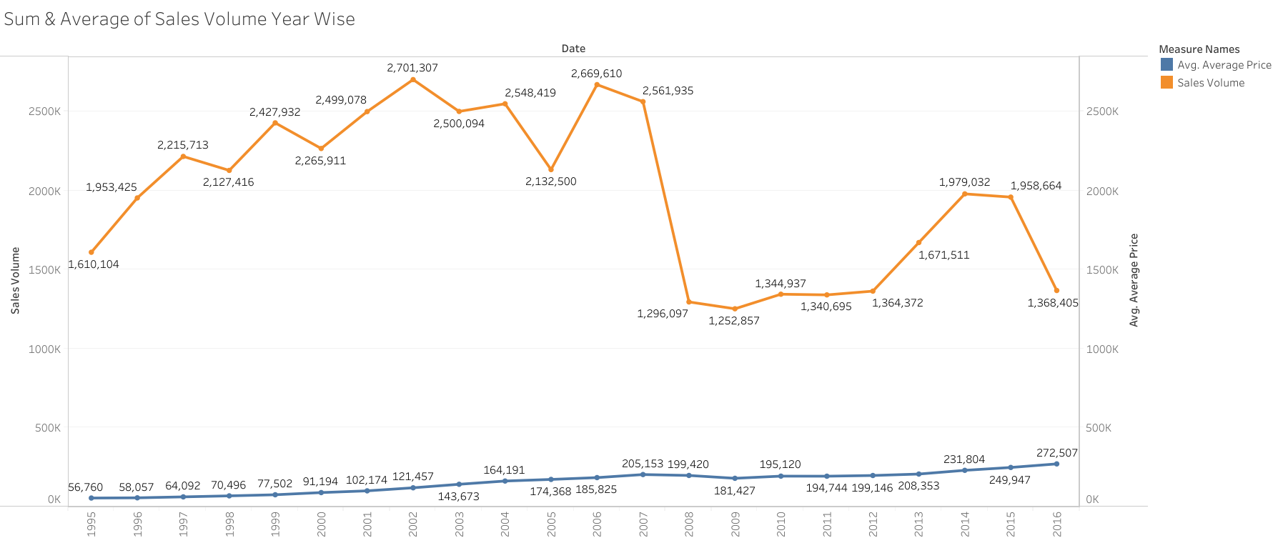

Slide 5
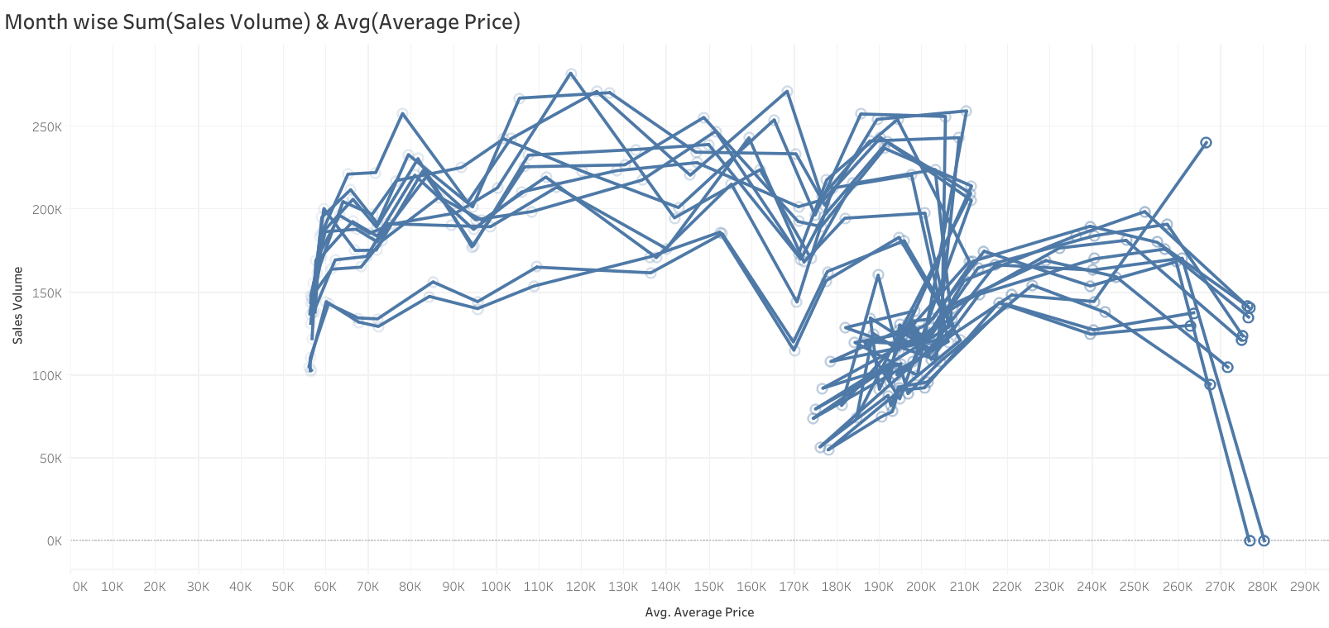

Slide 6
